Slide 1

Natural language processing
&
language modelling
High Performance Machine Learning Group

Slide 2
Content
How do we model:
Language
Words
Sequences
Context
Transformers
LLMs

Slide 3
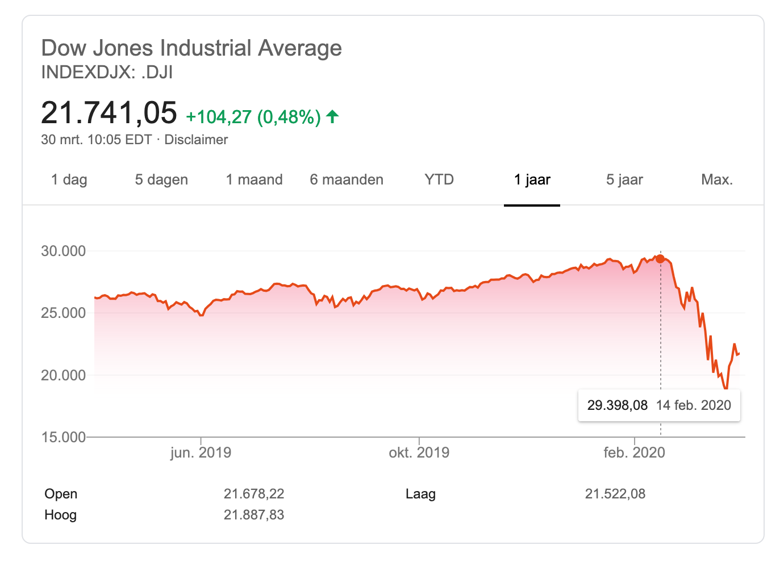
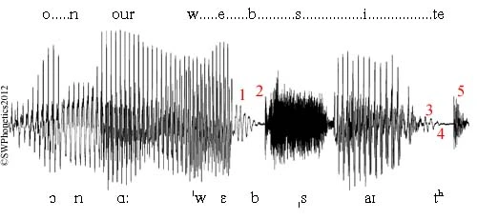
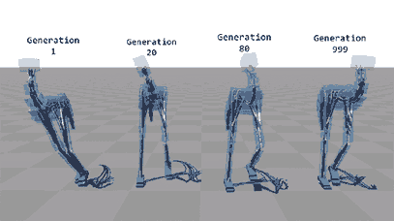
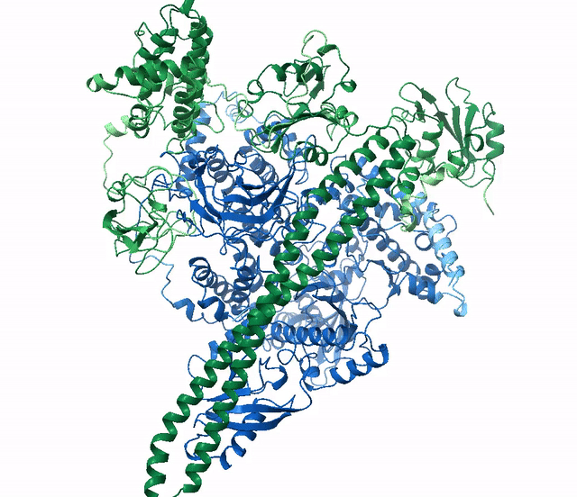
Sequential data
Universe seems to be inherently sequential

Slide 4
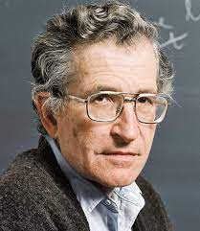
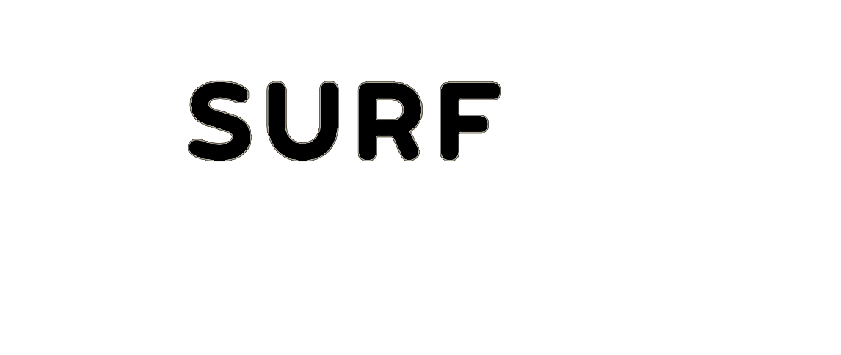
How can we model this?
Is there one (sequential) model to rule them all?
How does modelling language differ from other sequences?
“
Language is a process of free creation; its laws and principles are fixed, but the manner in which the principles of generation are used is free and infinitely varied.
~ Noam Chomsky

Slide 5
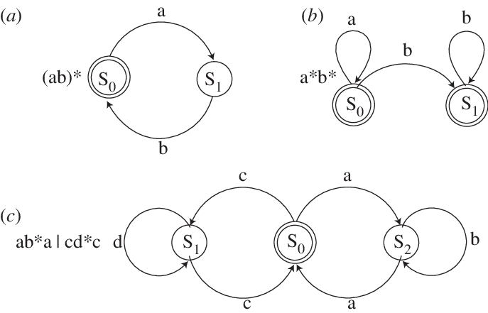
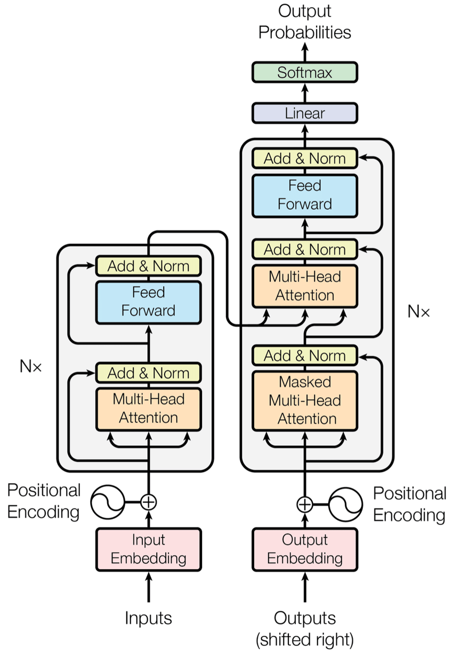
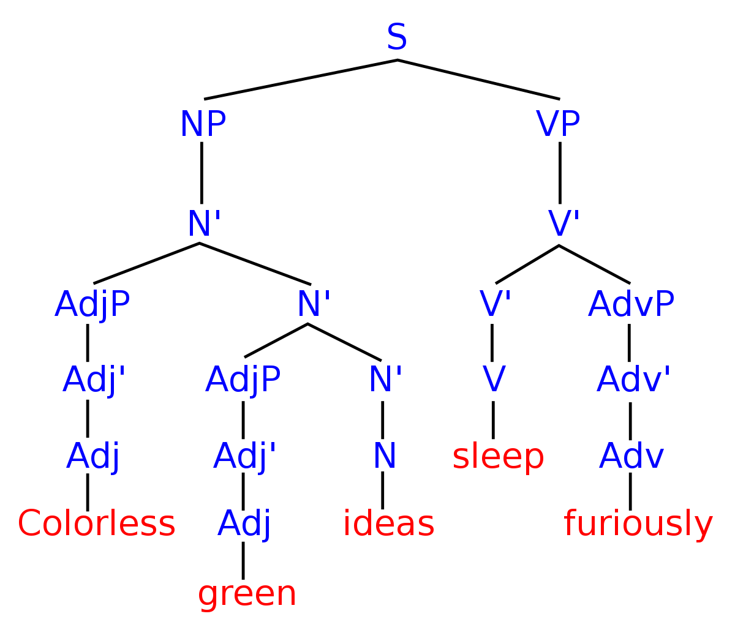
Sequential data
Modelling natural language
We have the innate ability for language (Universal Grammar)
Syntactic Structures
(Chomsky, N. 1957)
Different ways to model language:
Finite State Automata
Generative Grammars
Deep Learning + Data
….

Slide 6
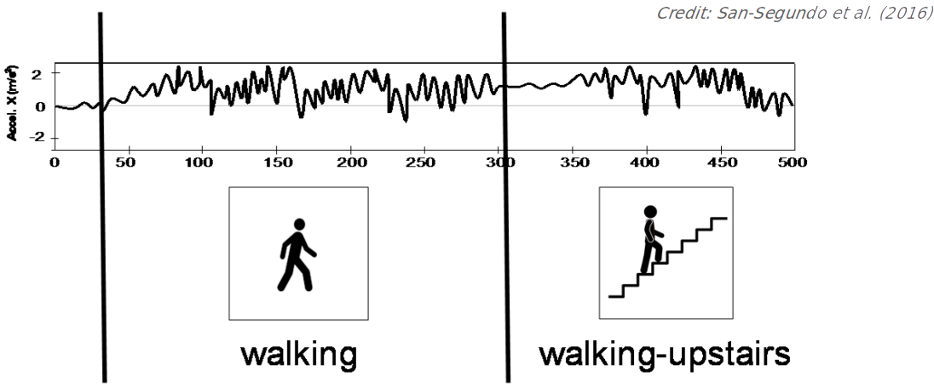
Human Activity Recognition

Slide 7
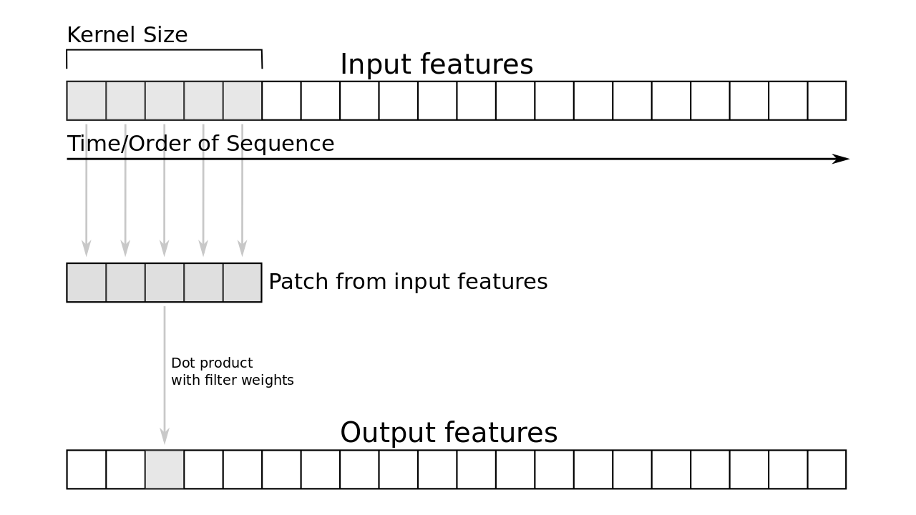
Human Activity Recognition
Can we use a CNN?
CNNs work here because they take nearby tokens into account

Slide 8
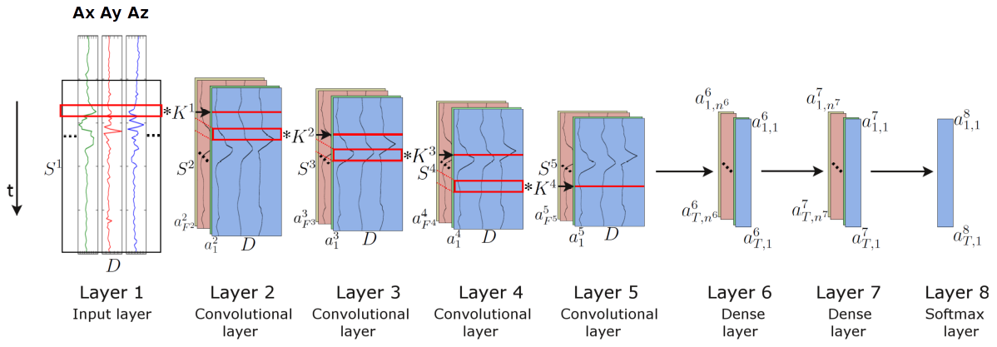
Human Activity Recognition
Can we use a CNN?
CNNs work here because they take nearby tokens into account

Slide 9
How to model language?
Language model objective:
Model the probability of the next symbol given the previous context by creating a probability distribution over language
Language models like ChatGPT model language left to right: one word at a time
📊
➡️

Slide 10

How to model language?
Language model objective:
Model the probability of the next symbol given the previous context by creating a probability distribution over language
Language models like ChatGPT model language left to right: one word at a time
📊
➡️

Slide 11
How to model language?
Use CNNs for modelling language?
CNN’s context size is small and does not remember past context
Language is very noisy and heavily (long-distance) context dependent

Slide 12
Neural representations
High Performance Machine Learning Group

Slide 13
How do we represent words?
Language is discrete!
“
One cat ate a tuna, one cat ate a chicken, one weird cat ate a human.

Slide 14
How do we represent words?
Language is discrete!
Vocabulary
A vocabulary is the set of unique tokens in your language (dataset)
“
One cat ate a tuna, one cat ate a chicken, one weird cat ate a human.

Slide 15
How do we represent words?
Language is discrete!
Vocabulary
one
cat
ate
tuna
chicken
weird
human
a
A vocabulary is the set of unique tokens in your language (dataset)
“
One cat ate a tuna, one cat ate a chicken, one weird cat ate a human.

Slide 16
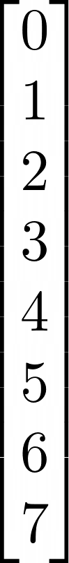
How do we represent words?
Language is discrete!
Vocabulary
one
cat
ate
tuna
chicken
weird
human
a
A vocabulary is the set of unique tokens in your language (dataset)
“
One cat ate a tuna, one cat ate a chicken, one weird cat ate a human.

Slide 17
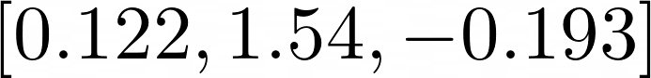
How do we represent words?
Language is discrete!
Vocabulary
one
cat
ate
tuna
chicken
weird
human
a
A vocabulary is the set of unique tokens in your language (dataset)
“
One cat ate a tuna, one cat ate a chicken, one weird cat ate a human.

Slide 18
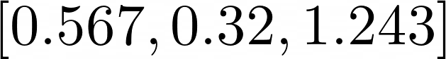
How do we represent words?
Language is discrete!
Vocabulary
one
cat
ate
tuna
chicken
weird
human
a
A vocabulary is the set of unique tokens in your language (dataset)
Embedding
“
One cat ate a tuna, one cat ate a chicken, one weird cat ate a human.
Easy to compose and easy to vectorize

Slide 19
How do we represent words?
Most basic: one hot encoding [0, 0, 1, 0, …., 0, 0]
❌ No meaningful distance between vectors
Word2Vec
Distributional hypothesis
The context surrounding a given word provides information about its meaning
Words are similar if they share similar contexts (semantic + syntactic)
Semantic similarity ≈ distributional similarity

Slide 20
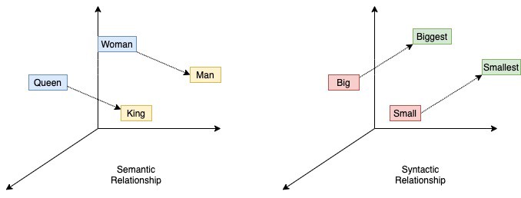
How do we represent words?

Slide 21
How do we represent words?
King - Man + Woman = Queen
Each word has a numerical vector representation
learnt by a language model

Slide 22
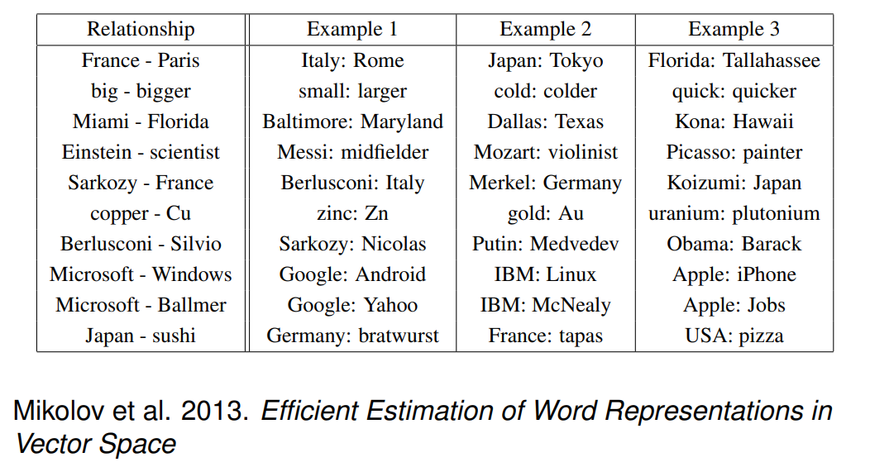
How do we represent words?

Slide 23
How do we represent words?
Context is important!
I go to the bank to transfer money.
I go to the river bank for a nice walk.

Slide 24
How do we represent words?
Context is important!
I go to the bank to transfer money.
I go to the river bank for a nice walk.
Static word embeddings like Word2Vec always have the same embedding.
Transformers will fix this! 🚀

Slide 25
From words to tokens
So far we have seen how to model words
Naive tokenization: split by spaces
Is this the most ideal way of feeding text to a model?

Slide 26
From words to tokens
So far we have seen how to model words
Naive tokenization: split by spaces
Is this the ideal way of feeding text to a model?
Vocabulary: [I, we, walk, walked, to, the, supermarket, market] (N=8)
Input string: I walk to the supermarket.
Tokenized: [0, 2, 4, 5, 7]
Input string: We walked to the market.
Tokenized: [1, 3, 4, 5, 7]

Slide 27
From words to tokens
So far we have seen how to model words
Naive tokenization: split by spaces
Is this the ideal way of feeding text to a model?
Vocabulary: [I, we, walk, walked, to, the, supermarket, market] (N=8)
Input string: I walk to the supermarket.
Tokenized: [0, 2, 4, 5, 7]
Input string: We walked to the market.
Tokenized: [1, 3, 4, 5, 7]
Input string: She walks to the marketplace.
Tokenized: [UNK, UNK, 5, 6, UNK]

Slide 28
From words to tokens
Solution #1: add all words to vocabulary
How many words are there for even a single language?

Slide 29
From words to tokens
Solution #1: add all words to vocabulary
How many words are there for even a single language?
Solution #2: split on characters
Super small vocabulary size (e.g. 26)

Slide 30
From words to tokens
Solution #1: add all words to vocabulary
How many words are there for even a single language?
Solution #2: split on characters
Super small vocabulary size (e.g. 26)
Solution #3: byte-pair encoding (BPE)
Start with each character as a separate token
Merge tokens that often occur together

Slide 31
From words to tokens
Solution #1: add all words to vocabulary
How many words are there for even a single language?
Solution #2: split on characters
Super small vocabulary size (e.g. 26)
Solution #3: byte-pair encoding (BPE)
Start with each character as a separate token
Merge tokens that often occur together
Each token should be a linguistically or statistically meaningful unit

Slide 32
From words to tokens
Solution #1: add all words to vocabulary
How many words are there for even a single language?
Solution #2: split on characters
Super small vocabulary size (e.g. 26)
Solution #3: byte-pair encoding (BPE)
Start with each character as a separate token
Merge tokens that often occur together
Each token should be a linguistically or statistically meaningful unit
Vocabulary sizes in common LLMs are increasing:
BERT: 30K
Llama2: 32K
LLama3.1: 128K
GPT4o: ~200K

Slide 33
How do we model sequences?
Unsupervised learning
Calculate error and update model
🤖
w₀
w₁
..
w_{n}
p₀
p₁
…
p_{n}
Training data 📚
Input
Prediction
Model

Slide 34
How do we model sequences?
Unsupervised learning
Training data 📚
Calculate error and update model
🤖
Yellow
Hungry
There
0.8
0.1
0.1
The monkey ate that banana because it was…
Input
Prediction
Model
True output

Slide 35
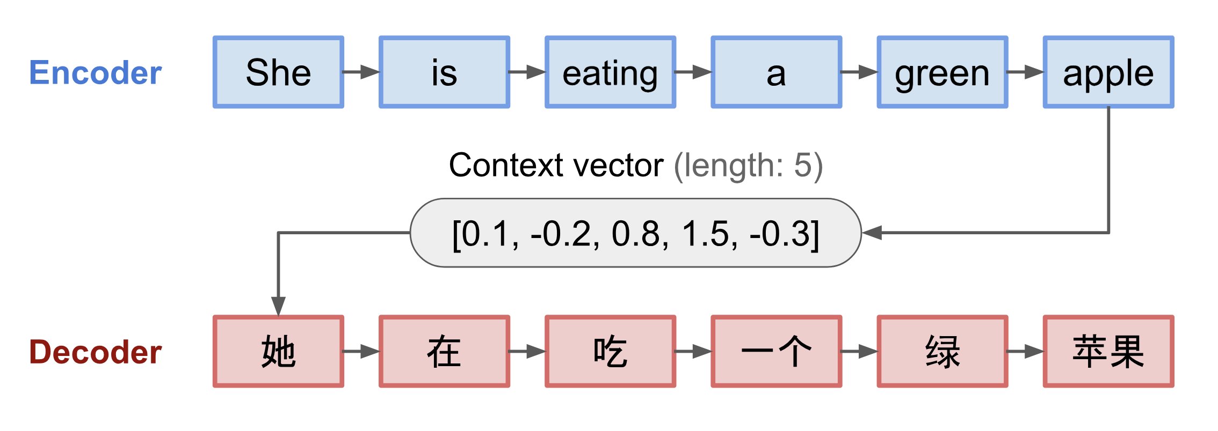
Encoder decoder
Image source

Slide 36
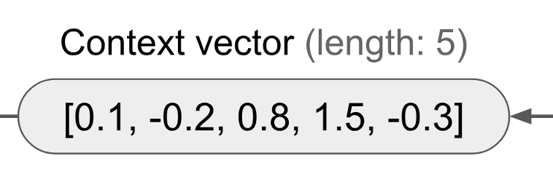
Encoder decoder
Fixed length context:
Last or average hidden state of network
Summary of entire source string
Model “forgets” what it has seen before

Slide 37
The Transformer
High Performance Machine Learning Group

Slide 38
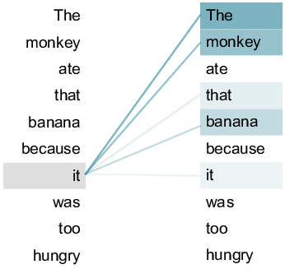
Attention
Weighted average over hidden states
Image source

Slide 39
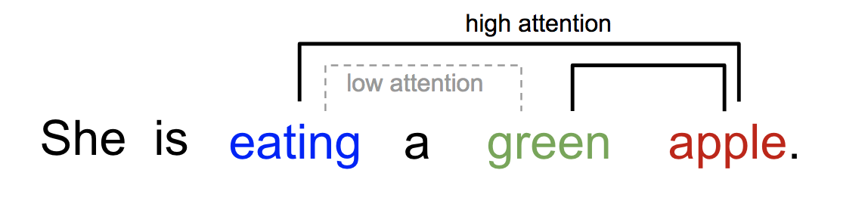
Attention is all you need: self-attention
Image source

Slide 40
Transformers
What is the importance of every element in the input sequence with respect to itself?
Every word directly connected to every other word
More parallelization!

Slide 41
Dissection of the Transformer
Encoder
Understanding the input

Slide 42
Dissection of the Transformer
Decoder
Generating the output

Slide 43
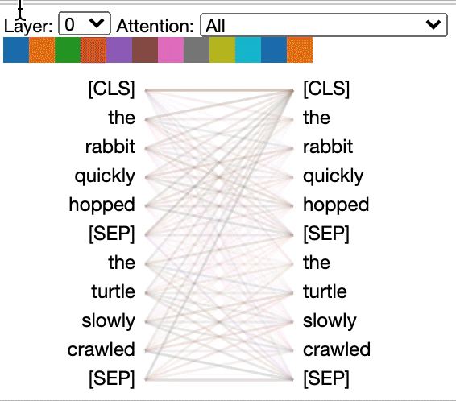
Dissection of the Transformer

Slide 44

Self Attention
Image source

Slide 45
Self Attention
Image source

Slide 46
Self Attention
Image source

Slide 47

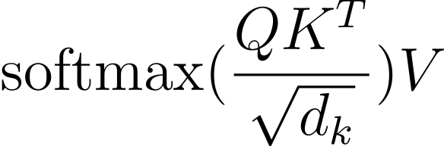
Self Attention

Slide 48
Self Attention

Slide 49
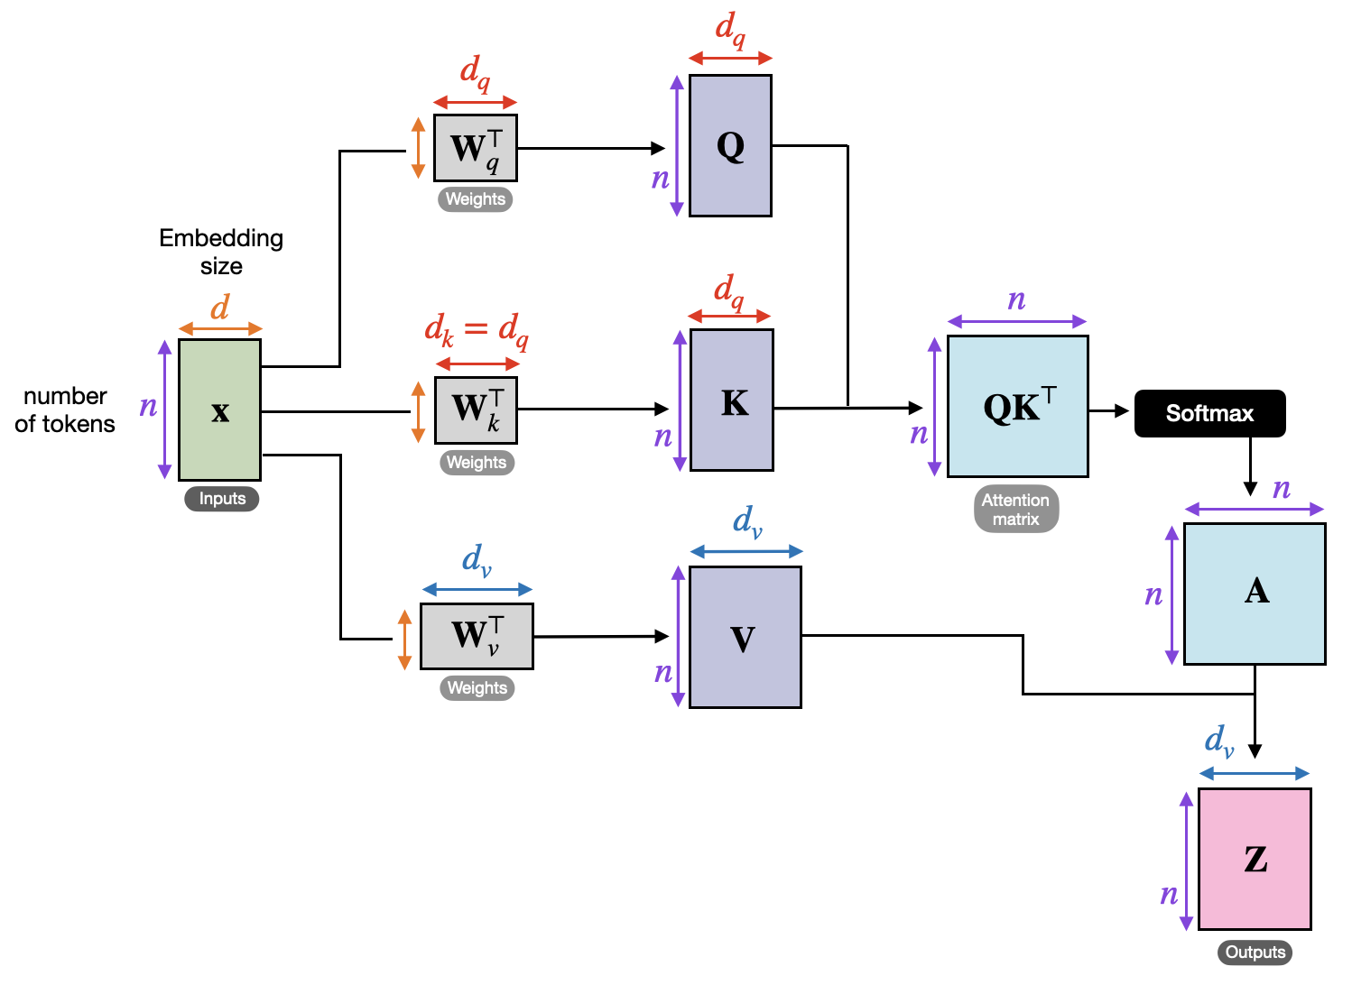
Self Attention

Slide 50
Self Attention

Slide 51
Self Attention

Slide 52
Self Attention

Slide 53
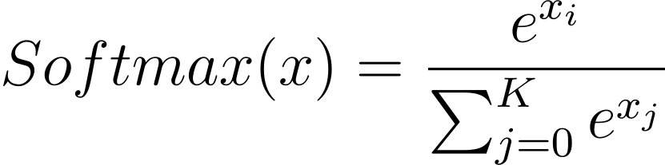
Self Attention

Slide 54
Self Attention

Slide 55

Self Attention

Slide 56
Self Attention

Slide 57
Dissection of the Transformer
Layer Normalization
Skip Connections
Positional Encoding
Byte Pair Encodings
Layer Stacking
Cross Attention

Slide 58
Self Attention

Slide 59
Self Attention

Slide 60

Model types
Decoder
Encoder
GPT
BERT
Text generation
Sequence classification
Encoder-decoder: T5
Sequence-to-sequence e.g. machine translation

Slide 61
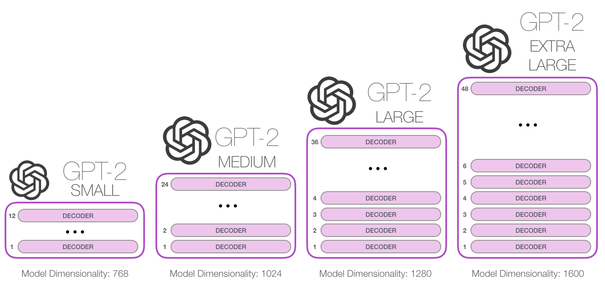
Generative Pre-Trained Transformers

Slide 62
From language models to chatbots
GPT: language model
ChatGPT: aligned language model
Alignment: what type of response is desirable? How can we make model behaviour be aligned with human norms and values?

Slide 63
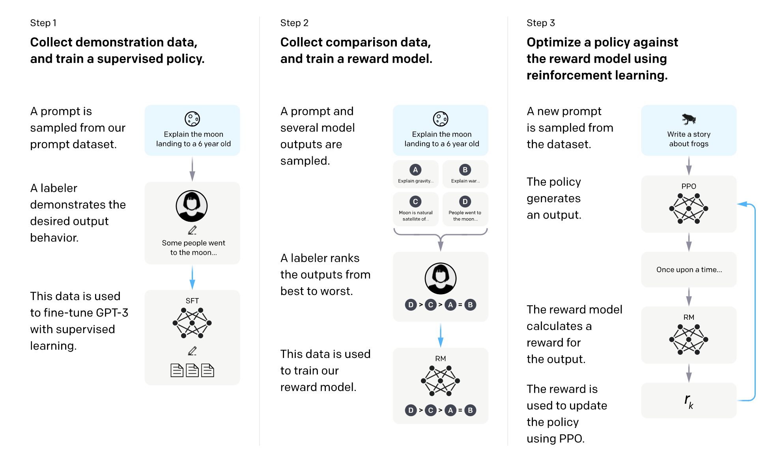
Alignment and instruction finetuning

Slide 64
Alignment and instruction finetuning

Slide 65
Alignment and instruction finetuning
Image source
Notes:
Reinforcement learning from human feedback
Proximal Policy Optimization (PPO)
Direct Preference Optimization (DPO)

Slide 66
Scaling Transformers
High Performance Machine Learning Group

Slide 67
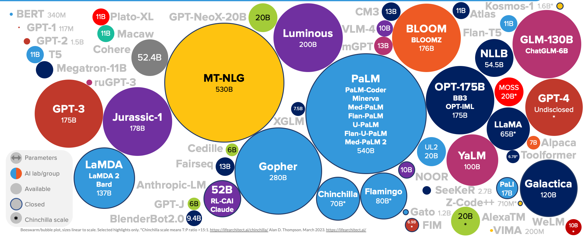
Cambrian Explosion of LMs
In comparison: the “big” model in original attention paper had only 213M parameters
Image source

Slide 68
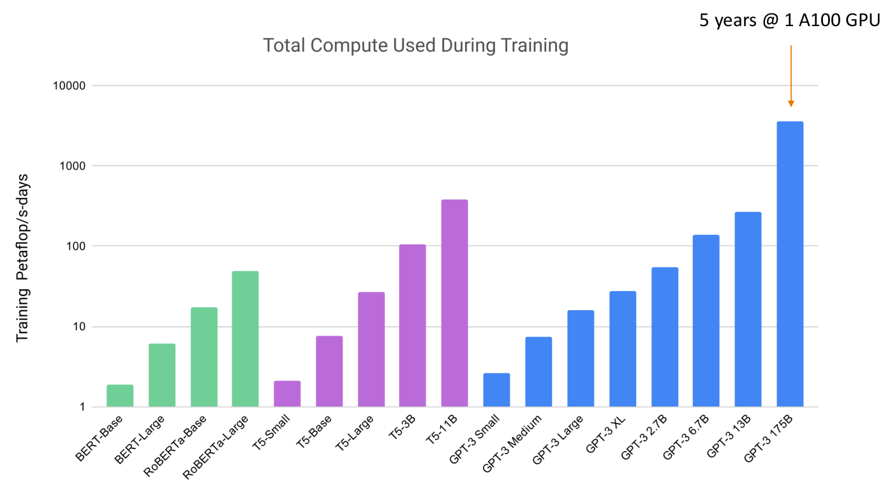
Transformer Explosion
GPT-3 Trained on ~350 Billion tokens
GPT-3 has 175B parameters!

Slide 69
Transformer Explosion
GPT-3 Trained on ~350 Billion tokens
GPT-3 has 175B parameters!
GPT4: in the range of
1.8T parameters, trained on >1T tokens.
3 months at 20.000 A100s…

Slide 70
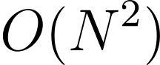
Transformer training is quite slow
We need a lot of data
And a lot of parameters

Slide 71
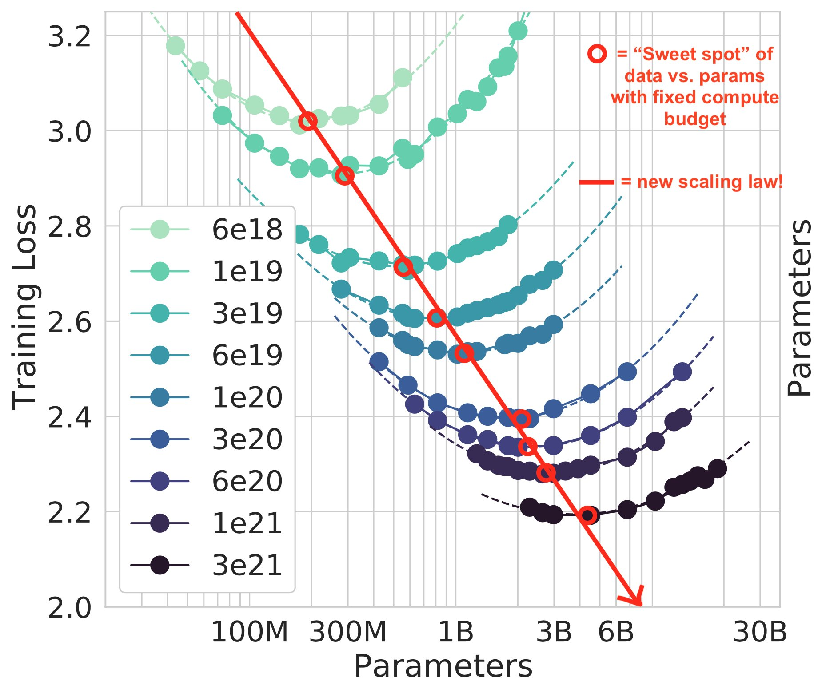
Transformers for other modalities: Whisper
Chinchilla Scaling Laws
Hoffmann, Jordan et al. “Training Compute-Optimal Large Language Models.” ArXiv abs/2203.15556 (2022): n. pag.

Slide 72
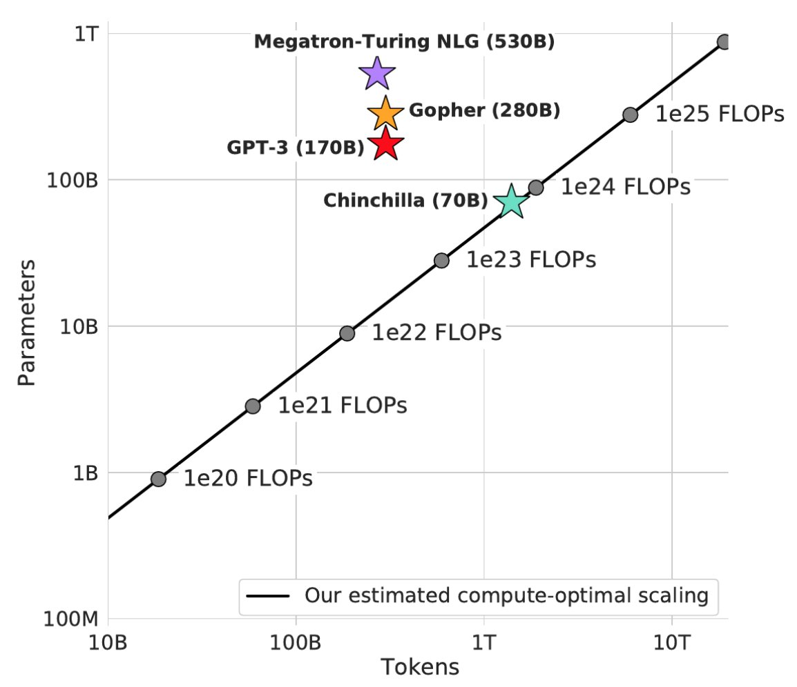
Transformers for other modalities: Whisper
Chinchilla Scaling Laws
Hoffmann, Jordan et al. “Training Compute-Optimal Large Language Models.” ArXiv abs/2203.15556 (2022): n. pag.

Slide 73
Finetuning LLMs at scale
High Performance Machine Learning Group

Slide 74
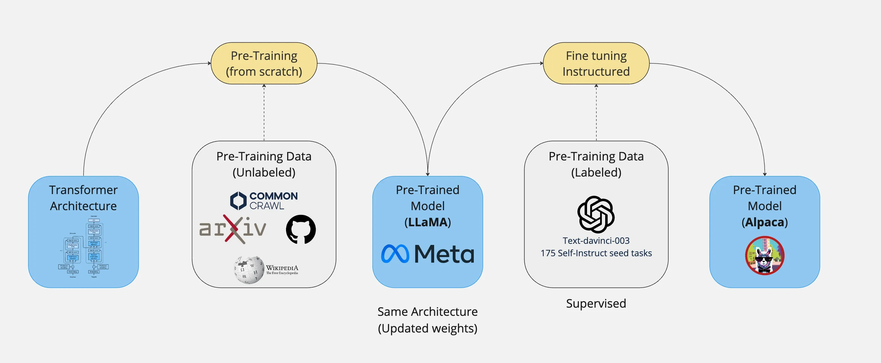
From training to finetuning
Image source

Slide 75
From training to finetuning
Current era of LLMS: few parties with enough data and compute to train large models
What can you do without requiring 1000 H100 GPUs? ☺

Slide 76
From training to finetuning
Current era of LLMS: few parties with enough data and compute to train large models
What can you do without requiring 1000 H100 GPUs? ☺
Use foundation models as they are:
- In-context learning
- Retrieval augmented generation
No training
Finetuning
Transfer learning: finetune model to adapt to specific task

Slide 77
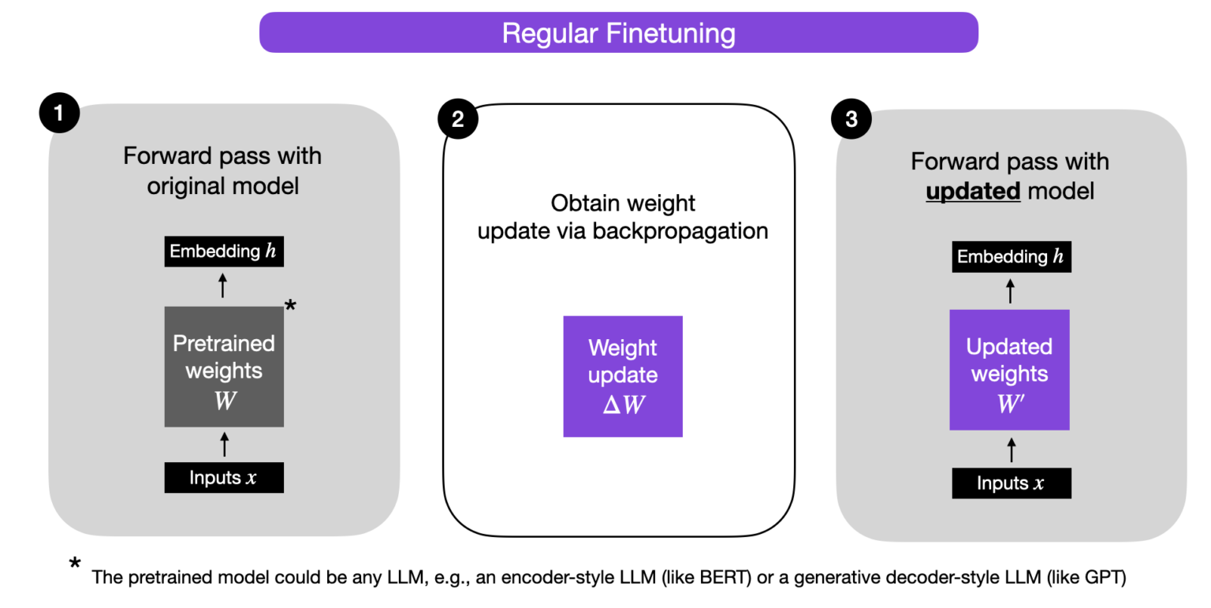
Efficient parameter optimization
Often not necessary to change all parameters
Image source

Slide 78
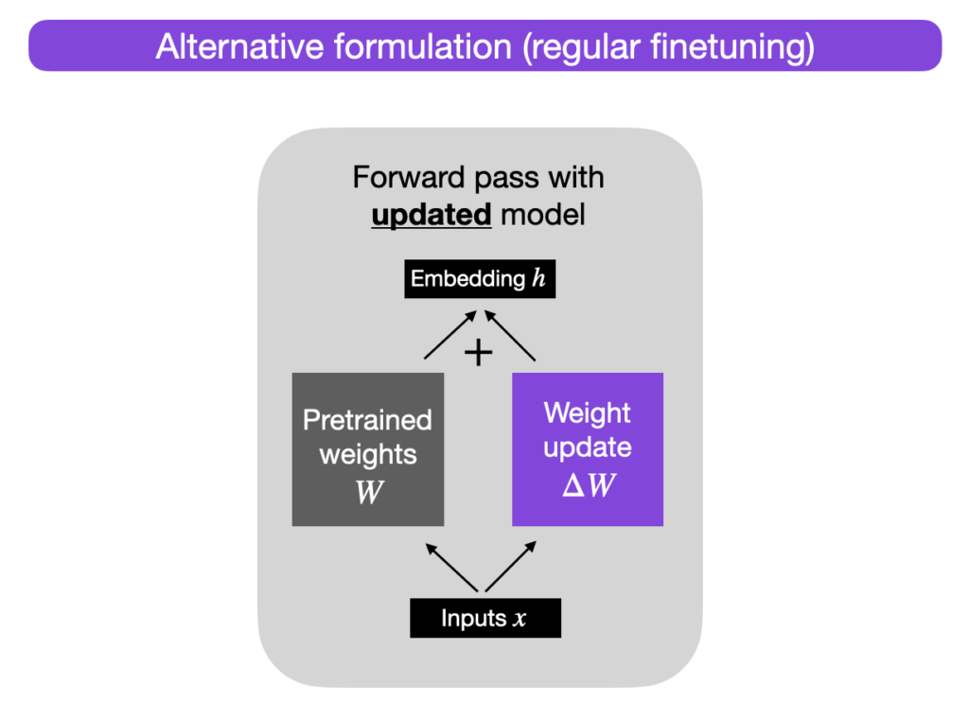
Efficient parameter optimization
Often not necessary to change all parameters
Image source

Slide 79
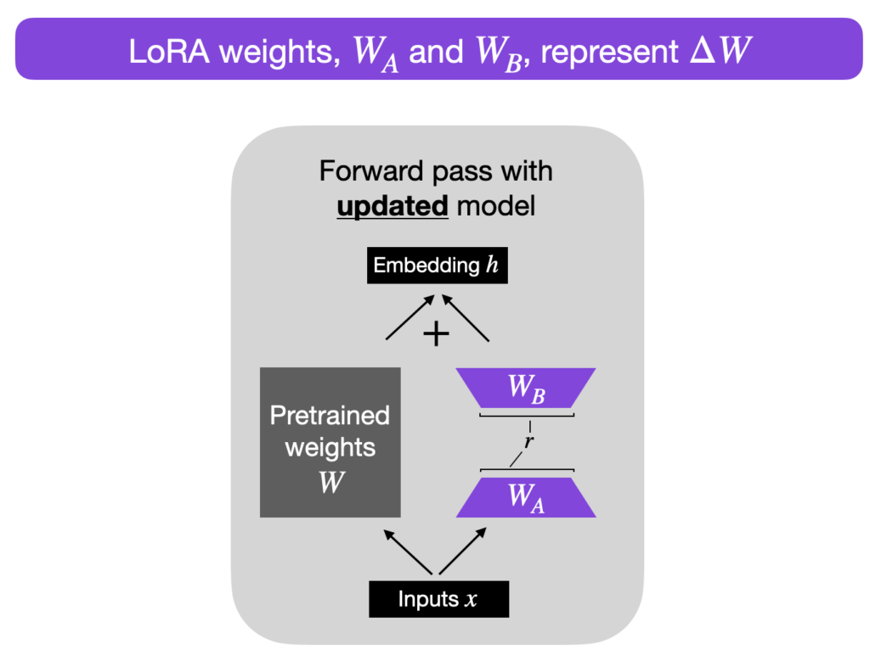
Efficient parameter optimization
Often not necessary to change all parameters
Image source

Slide 80
Efficient parameter optimization
Often not necessary to change all parameters
Reduces parameters in vram by about 4x!
Example:
LLama 7B in FP:
4 (bytes) x 7 = 28GB
(inference)
8 (bytes) x 7 = 56GB
(training)
This can go down to 14GB with PEFT!
Image source
Notes:
Low rank -> redundant rows or columns
Smaller r -> faster/less parameters, reduced generalizability

Slide 81
Considerations
💬 Social bias
⚖️ Legal limitations
❗️ Trust and reliability
Confident talking parrot
📣 Disinformation
🌳 Environmental impact

Slide 82
Transformers for
other modalities
High Performance Machine Learning Group

Slide 83
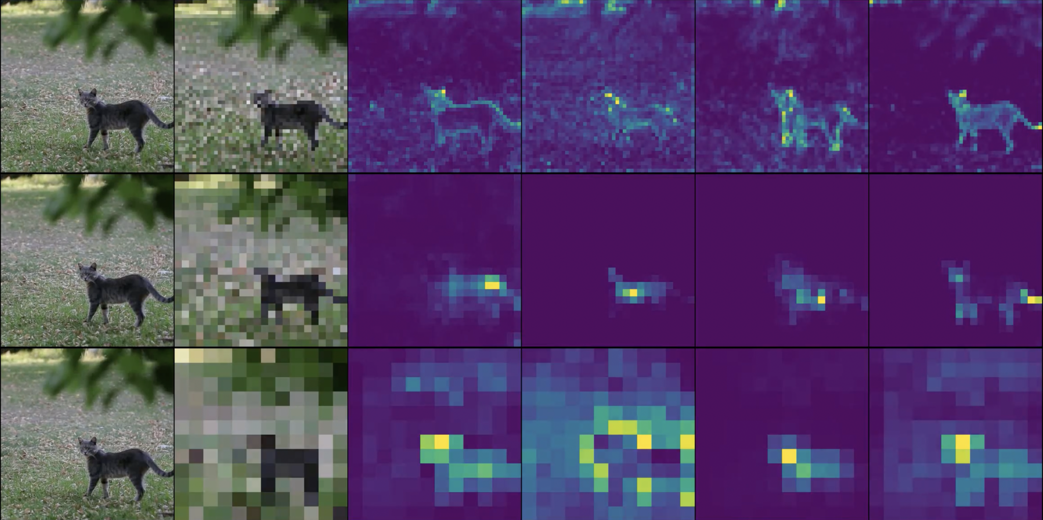
Transformers for other modalities: ViT

Slide 84
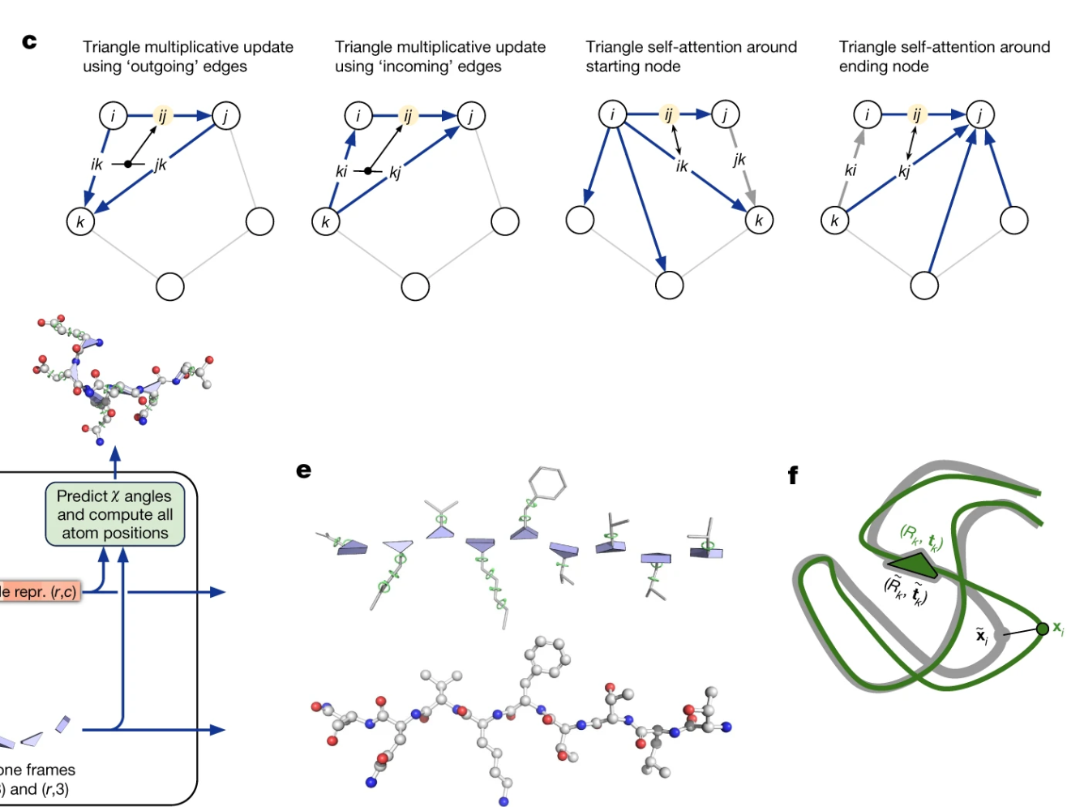
Transformers for other modalities: EvoFormer
https://www.nature.com/articles/s41586-021-03819-2

Slide 85
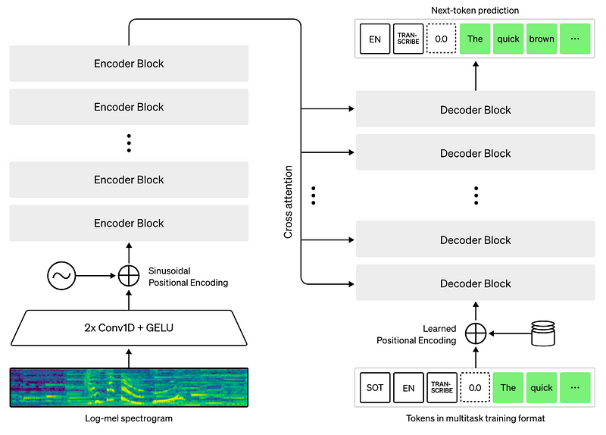
Transformers for other modalities: Whisper
Transformers for other modalities: Whisper
https://openai.com/research/whisper

Slide 86



Want to learn more?
Use existing (efficient!) frameworks
Make use of SURF guides for efficient finetuning: https://servicedesk.surf.nl/wiki/display/WIKI/LLM+finetuning+on+Snellius

Slide 87
Fin
Introduction Series

